Slide 1
Economics 144 Economic Forecasting
Lecture 1
Economic Forecasting: The Basics
Dr. Randall R. Rojas

Slide 2
Useful References
Books:
Applied Econometric Time Series, 3rd Ed., W. Enders (Easy)
A Companion to Economic Forecasting. M. P. Clements and D. F. Hendry (Medium)
Time Series Analysis. J. D. Hamilton (Difficult)
Time Series Applications to Finance with R and S-Plus, 2nd Ed., N.G. Chan (includes R codes)
Analysis of Financial Time Series, 3rd Ed. Ruey S. Tsay (includes R codes)
http://faculty.chicagobooth.edu/ruey.tsay/teaching/ →teaching→Business 41202
Time Series Analysis and its Applications with R Examples, 3rd Ed. Robert H. Shumway & David S. Stoffer (includes R codes)
Journals:
Journal of Forecasting
International Journal of Forecasting
Journal of Business and Forecasting
Journal of Business and Economic Statistics
Review of Economics and Statistics
Journal of Applied Econometrics
Online information:
Resources for Economists (www.rfe.org)
Economagic (http://www.economagic.com)

Slide 3
Overview of Economic Forecasting _{1 of 2}
Q1: What is a forecast?
Ans: A forecast is a statement about the future.
Note: Forecasting = the science and the art to predict a future event with some degree of accuracy.
Q2: How is forecasting done by economists?
Ans: In economics, methods of forecasting include:
Guessing, “rules of thumb”, or “informal models”
Expert judgment
Extrapolation
Leading indicators
Surveys
Time Series models
Econometric systems

Slide 4
Overview of Economic Forecasting _{2 of 2}
Q3: What are the main problems?
Ans: One of the main problems with forecasting in economics is that economies evolve over time and are subject to intermittent, and sometimes large, unanticipated shocks.
Q4: What are some relevant forecast examples?
Ans: Some of the relevant areas include:
Operations planning and control
Marketing
Economics
Financial asset management
Financial risk management
Demography
Crisis management

Slide 5
Standard Notation
Description | Technical name | Notation
Object to analyze: | Time series
Value at present time t : | Known value of the series
Future at time t+h: | Random variable
Value at future time t+h: | Unknown value of the random variable
Collection of information : | Univariate information set Multivariate information set
Final objective: | Forecast 1-step ahead h-step ahead
Uncertainty: | Forecast error

Slide 6
Six Fundamental Considerations in Forecasting The Forecast Object _{1 of 1}
Event Outcome Forecasts: Event is certain, outcome is unknown, timing known.
Event Timing Forecasts: Event is certain, outcome is known, timing unknown.
Time Series Forecasts: Project the future value of a time series. (most commonly encountered)
Event outcome
Event timing
Time Series
Forecast Object

Slide 7
Six Fundamental Considerations in Forecasting The Forecast Statement _{1 of 2}
What will the forecast result be?
Point Forecast: Single number (e.g., μ).
Interval Forecast: Range of values. (~confidence interval, e.g., μ ± z*σ).
Density Forecast: Probability Distribution of the of the future value of the series (e.g., N(μ, σ² )).
Most common!
less information
more information

Slide 8
Six Fundamental Considerations in Forecasting The Forecast Statement _{2 of 2}
Probability Density
Density Forecast
5%
5%
GDP Growth
-2.3%
1.3
Point Forecast
4.3%
90% Interval Forecast

Slide 9
Six Fundamental Considerations in Forecasting The Forecast Statement _{2 of 2}
Interval forecast
Density forecast
Conditional probability
density function of
.
.
.
.
Point forecast
0
1
2
……………..
t
t+h
time
Information set

Slide 10
Six Fundamental Considerations in Forecasting The Forecast Horizon _{1 of 2}
Forecast Horizon: Number of periods between today and the end date of the forecast.
In general: h-step-ahead forecast (where h is the step length). The horizon is fixed (h is constant).
h-step-ahead extrapolation forecast: Includes all steps from 1-step-ahead to : h-steps-ahead.
Example: Today: Year =T
→Forecast GDP for year T+5→Forecast horizon of 5 steps.

Slide 11
Six Fundamental Considerations in Forecasting The Forecast Horizon _{2 of 2}
Series or Forecast
In-sample historical data
Out-of-sample forecast
*
*
*
*
4-Step-Ahead Extrapolation Point Forecast
Time
1 2 … T-1 T T+1 T+2 T+3 T+4
4-Step-Ahead-Point Forecast

Slide 12
Six Fundamental Considerations in Forecasting The Information Set _{1 of 1}
Your forecast is conditional on the quality and quantity of your data.
Questions:
What information is available?
What else could be collected? Or made available?
Quantitative or Qualitative?
Can the data be used more efficiently?
Univariate Information Set:
Ω_{T}^{univariate}={y_{T} , y_{T-1} ,…,y₁}
Multivariate Information Set:
Ω_{T}^{multivariate}={x_{T} , y_{T,} , x_{T-1}, y_{T-1} …, x_{1,} y₁}

Slide 13
Six Fundamental Considerations in Forecasting Models and Complexity, The Parsimony and Shrinkage Principles _{1 of 1}
Your modeling strategy should be based on your forecast task.
For out-of-sample forecasting in business, finance, and economics, simple (parsimonious) models are better.
Parsimony Principle: All other things being equal, simpler models are better than complex ones.
Shrinkage Principle: Imposing restrictions on forecasting models often improves forecast performance.
KISS Principle: Keep It Sophisticatedly Simple

Slide 14
Example: Trends Annual Hours Worked in the OECD Countries 1979-2006
Source: http://www.oecd.org

Slide 15
Example: Cycles Unemployed Persons (Seasonally Adjusted), Monthly Data 1988-2008
Source: St. Louis Federal Reserve Bank. FRED

Slide 16
Example: Seasonality Revenue Passenger Enplanements. Monthly Data 2000-2008
Peaks occur regularly around July
Source: Bureau of Transportation Statistics

Slide 17
Example: Combined New Home Sales in the United States. Quarterly Data 2004-2008
Source: National Association of Realtors

Slide 18
A Gentle Review of Probability, Statistics, and Regression
I. RVs, Distributions, and Moments
II. Multivariate RVs
III. Statistics
IV. Regression Analysis

Slide 19
I. Random Variables, Distributions and Moments _{1 of 5}
Random Variables
Discrete
→Probability Mass Function (pmf)
Continuous
→Probability Density Function (pdf)
pmf
f(x)
pdf
f(x)
x
x

Slide 20
I. Random Variables, Distributions and Moments _{2 of 5}
Random Variables (RVs): Represent the outcomes from random phenomena.
Discrete RVs: Take on only a countable number of distinct values.
Probability Mass Function (pmf): Assigns probabilities to the outcomes associated with discrete random variables. →pmf=P(X=x) = f(x)
Continuous RVs: Take on an infinite number of possible values.
Probability Density Function (pdf): Assigns probabilities to the outcomes associated with discrete random variables. →pdf=f(x)

Slide 21
I. Random Variables, Distributions and Moments _{3 of 5}
Example 1: Discrete Probability Distribution
Flip a coin twice. Let X = number of heads.
4 possible outcomes
T
T
→ Sample Space: Ω={HH, HT, TH, TT}
x (value) | Probability: P(X=x) = f(x)
0 | 1/4 =0.25
1 | 2/4=0.50
2 | 1/4=0.25
T
H
H
T
f(x)
H
H
0.50
0.25
0.00
x

Slide 22
I. Random Variables, Distributions and Moments _{4 of 5}
K = Kurtosis (peakedness)
f(x)
μ = Mean or Expected Value (central tendency)
σ = Standard Deviation (spread around the mean)
S = Skewness (lopsidedness)
x
Moments of a Distribution

Slide 23
I. Random Variables, Distributions and Moments _{5 of 5}
Moments: Describe the shape of the distribution*.
Mean: Measures the central tendency of X.
Variance: Measures the dispersion around μ
Standard Deviation: Measured the spread around μ.
Skewness: Measure the lopsidedness (symmetry) of the distribution.
Kurtosis: Measure of whether the distribution is tall and skinny or short and squat.
*With respect to the normal distribution.

Slide 24
II. Multivariate Random Variables _{1 of 3}
Joint Distribution: P(X=x, Y=y) =f(x,y)
z
z =f(x,y)
Marginal Distribution of X
y
z
x
x
Marginal Distribution of Y
(Normalization)
y

Slide 25
II. Multivariate Random Variables _{2 of 3}
Covariance: Is a measure of how much two* random variables change together.
Correlation: Is a measure of the relation between two random variables.
(Does not have units)
where
*There can be more than two random variables.

Slide 26
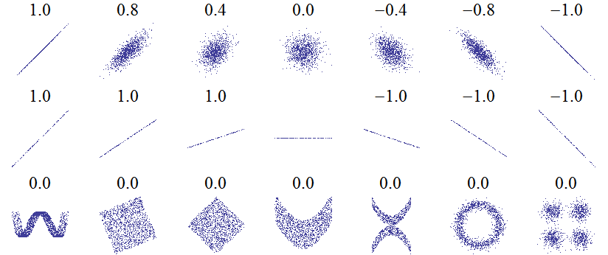
II. Multivariate Random Variables _{3 of 3}
Examples of Correlations between Two Random Variables
Strongly correlated* (ρ _{X,Y} =±1)
Weakly correlated.
Covariance and correlation measure only linear dependence.

Slide 27
III. Statistics ₁ _{of 2}
In practice (quite often) we have a sample of data from un unknown distribution f.
Compute the sample
moments via estimators.
Sample of data
(have)
Unknown distribution
(want)
73 | 70 | 92 | • •• | 68
(sample mean)
Grades
(sample standard deviation)

Slide 28
III. Statistics ₂ _{of 2}
Sample Mean:
Sample Variance:
Sample Standard Deviation:
Sample Skewness:
Sample Kurtosis:
Jarque-Bera Test:
where
Used to test for normality (S=0, K=3) of a distribution.

Slide 29
IV. Regression ₁ _{of 9}
Scatterplot of y vs x
Regression Line
y
observed (y)
e_{t}
fitted (ŷ)
x

Slide 30
IV. Regression ₂ _{of 9}
Residuals (e_{t}): difference between the observed and predicted value →e_{t}= y_{t}-ŷ_{t}
Least Squares Line: Is the best fit line such that
Σ (residuals)² is minimized.
Linear Regression Model: Model that describes the data (for the linear case).
data = linear part + noise

Slide 31
IV. Regression ₃ _{of 9}
Fitted Values (ŷ_{t}): in-sample forecasts
Data [y] = Model[ŷ_{t}] + Residuals[e_{t}]
Correlation coefficient:
,
Perfect correlation→r = ±1
r >0
r <0
r =0

Slide 32
IV. Regression ₄ _{of 9}
Coefficient of Determination (R² or r²): Fraction of the data’s variation accounted for by the model.
Example: R² =0.80
Data [y] = Model[ŷ_{t}] + Residuals[e_{t}]
100% = 80% + 20%
Residuals: If the linear model is a good model for the data, there should be no structure in the plot of the residuals vs. x (or vs. ŷ). It should look like random points.
Perfect model→R² = 1 where

Slide 33
IV. Regression ₅ _{of 9}
Least Squares Line:
Slope:
Intercept:
The LS line goes through the centroid of the data.

Slide 34

IV. Regression ₆ _{of 9}
Example (Raw Data):
Year Revenue($M) Expenses($M) Income($M) Share ($M)
2000 19889.00 8551.00 2177.00 20834.00
2001 20092.00 8696.00 3969.00 22417.00
2002 19564.00 7001.00 3050.00 11800.00
2003 20857.00 7287.00 4347.00 14090.00
2004 21742.00 7890.00 4847.00 15935.00
2005 23104.00 8739.00 4872.00 16355.00
2006 24088.00 9431.00 5080.00 16920.00
2007 28857.00 10945.00 5981.00 21744.00
2008 31944.00 11774.00 5874.00 20472.00
2009 30990.00 11358.00 6906.00 24799.00
2010 35119.00 13158.00 11859.00 31003.00

Slide 35
IV. Regression ₇ _{of 9}
Example (Distributions):
Revenue ($M)
Expenses ($M)
Income ($M)
Share ($M)

Slide 36
IV. Regression ₈ _{of 9}
Expenses
Residuals
Revenue
Fitted
Q: Does the linear regression model seems to work well for these data?
Yes!

Slide 37
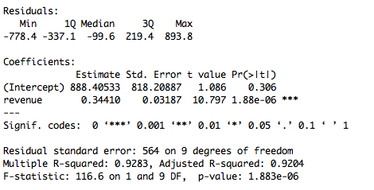
IV. Regression ₉ _{of 9}
Tests one variable at a time.
Tests all variables together.
(Model)

Slide 38
Background on R ₁ _{of 3}
R commands to do the regression model:
z0=read.table("data.txt", header = TRUE)
ym=lm(expenses~revenue)
summary(ym)
Read in the data
Compute the LS fit
Show results
R is a very powerful language for data mining large (and small) data sets. There are numerous built in functions for almost any application of interest. In addition, it easy to build your own functions to meet your specific computing needs. Currently it is one of the most widely used software across many fields, and knowing how to use it is in very high demand!

Slide 39
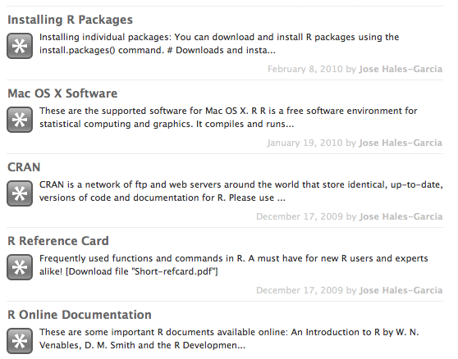
Background on R ₂ _{of 4}
Step 1 (Download R):
http://cran.stat.ucla.edu/
Step 2 (Install all packages):
install.packages(available.packages()[,1])
Step 3 (Try it out!):
http://answers.stat.ucla.edu/groups/answers/search/?q=R&tag=r

Slide 40
For Next Class
Readings about today’s class:
Chapters 1ª, 2ª, 1^{b}, 2^{b}, 3^{b}
For next class:
Download, install and have fun with R (try to repeat the regression example from today’s class)
Readings for next class:
Chapters 3ª, 4ª, 4^{b}

